Slide 1
FIND A WAY
Amer Toukan, Raj Sandhu, Stephanie Collins, Tyson Parkin, and Vidhi Panchal

Slide 2
CONCEPT
Helps with choosing between driving and parking, or taking an Uber.
Displays the cost of both side by side
Notes:
Find A Way seeks to remove the guesswork from discerning which is more cost effective for a desired trip: driving oneself and finding a parking spot or taking an uber.
It does so by displaying the costs of driving and parking, and taking an Uber, side by side, to the user.

Slide 3
MOTIVATIONS BEHIND DEVELOPMENT
Saving money
Deciding if available parking is sufficient for user’s needs
Convenience
Notes:
The driving motivation (pun intended?) for this application is making the process of deciding between driving & parking or taking an uber more convenient and pragmatic.
It is far more convenient to have the results for those options displayed side by side, at the same time, to the user, and pragmatic in that it gives reliable pricing for both options, in addition to displaying the closest parking all at the same time.
These features appeal not only to users who don’t want to spend their money unnecessarily, but also to anyone who would benefit from knowing how far away the nearest available parking is.
A user will be able to make an informed decision regarding whether available parking is farther than is feasible or reasonably convenient for them.
Ultimately, the user is saved the trouble of making multiple queries through various search interfaces to determine what might be a better option for them.

Slide 4
DESIGN PROCESS
Initial vision was cost of driving and parking displayed side by side with price of an Uber and a Lyft to the same destination
Trips to Toronto were the main focus in project’s early stages, but the parking API we found is only for destinations in the U.S.
Used static average of fuel prices until we found a gas price API that worked
Notes:
Our group initially identified some core issues for our application. We wanted it to have a form that captures the user’s current and desired end destinations. We wanted it to determine the cost of an Uber, as well as the cost of gas for driving oneself and parking, on submit.
We had also wanted to include Lyft’s API in our application, but currently have that issue in our icebox, as the Uber API’s terms of use prohibit displaying comparisons between Uber and competitors.
Aside from Lyft, we were able to check off the five initial issues. It definitely took a lot of trial and error to find the right APIs, and to get them to work.
The result of our trial and error remains true to our initial vision, and displays the costs of driving and parking, and of taking an Uber pool or Uber X, side by side to the user.
Now, we’d like to talk to you about how Find A Way works.

Slide 5
TECHNOLOGIES USED
Firebase
Google Geocode API
Park Whiz API
Uber API
Notes:
The application utilizes HTML, CSS, and Bootstrap for the user interface design.
Javascript and jQuery were used along with AJAX to communicate with the various APIs used.
We also utilized the moment.js library to get our trip start and end times as UNIX strings.
Firebase is used to store data about each trip, mainly for developer use. The details which are stored are the user’s current location, trip destination, number of passengers, and stated departure time.
The Google Geocode API is used to get the longitude and latitude for the user’s current location and destination. These values are used with the Park Whiz and Uber APIs to get cost and duration estimates.
The application uses the Park Whiz API to get the minimum parking price for the user’s destination. This API is also used in a function to calculate the total cost of gas for driving and parking. The function approximates the cost of gas for the trip using the 2018 Canadian Vehicle Fuel Consumption average, and using the average price of gas in Ontario for 2017. The results page also links the user to Park Whiz’s website to see the minimum price parking listing, as well as others nearby the user’s destination.
The Uber API is used to get the duration and price of both an Uber X and an Uber pool. There is also a link to the Uber application on the results page.
Now we’d like to show you all the application in action.

Slide 6
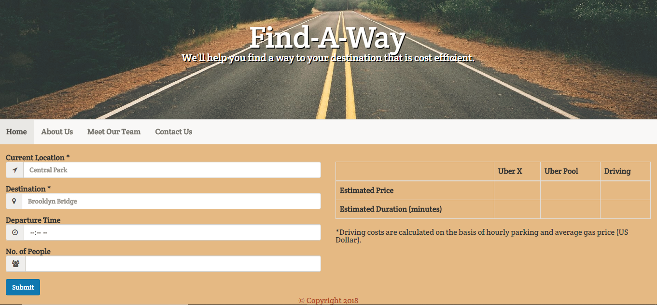
APPLICATION IN ACTION

Slide 7
DIRECTIONS FOR FUTURE DEVELOPMENT
Lyft
User can input number of hours they plan to park as part of cost calculation
Parking in Ontario, more of Canada
Getting the current Gas Price
Using the ride request from the Uber

Slide 8
THANK YOU FOR LISTENING!

